Slide 1
IBM Data Science Capstone Project

Slide 2
Introduction
Lahore is a city of Pakistan. There are few towns that are old, and few are built in recent past. People come here to seek jobs and to start their own business. For a person planning to settle in Lahore, he/ she will be having difficulty to choose the best town. More facilities surrounded by the town may be a perfect choice for someone. This project aims to provide a overview of all the town w.r.t nearby venues like restaurants, shopping malls etc.

Slide 3
Data Lake
Data Preparation Phase: Data of Towns in Lahore is available in Excel Format.
Geographical coordinates of the Town will be getting from online sources (OpenStreetMap or arcgis)
Obtain the venue data for the Towns from Foursquare API
Explore and cluster the Towns
Select the best Town

Slide 4
Necessary Libraries
pandas
numpy
json
geopy.geocoders
Nominatim
geocoder
requests
pandas.io.json json_normalize
Matplotlib
matplotlib.colors
sklearn.cluster
KMeans
import folium

Slide 5
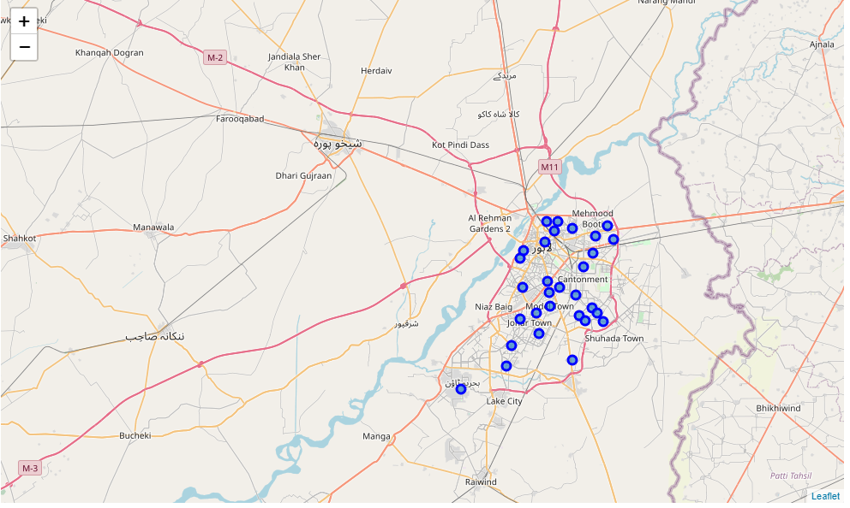
Lahore Towns

Slide 6
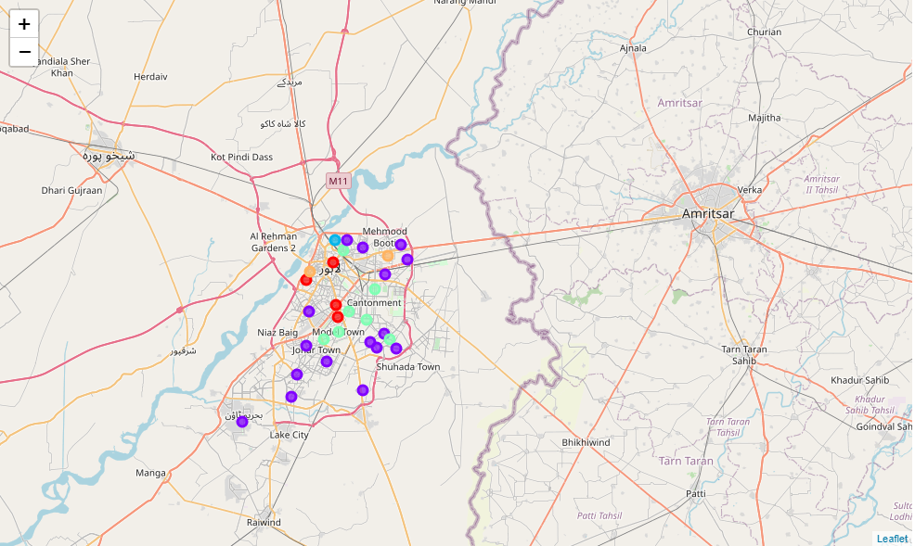
After Clustering

Slide 7
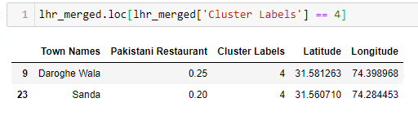
Final Observation
As can be seen above, cluster 5 [Index 4] is having high percentage of Pakistani Restaurants around them. A foodie person moving into Lahore would prefer this location.

